Slide 1
Intro to Algorithms As Opinions!

Slide 2
What is an
“algorithm”?

Slide 3
Algorithm
Steps to change input
output
input

Slide 4
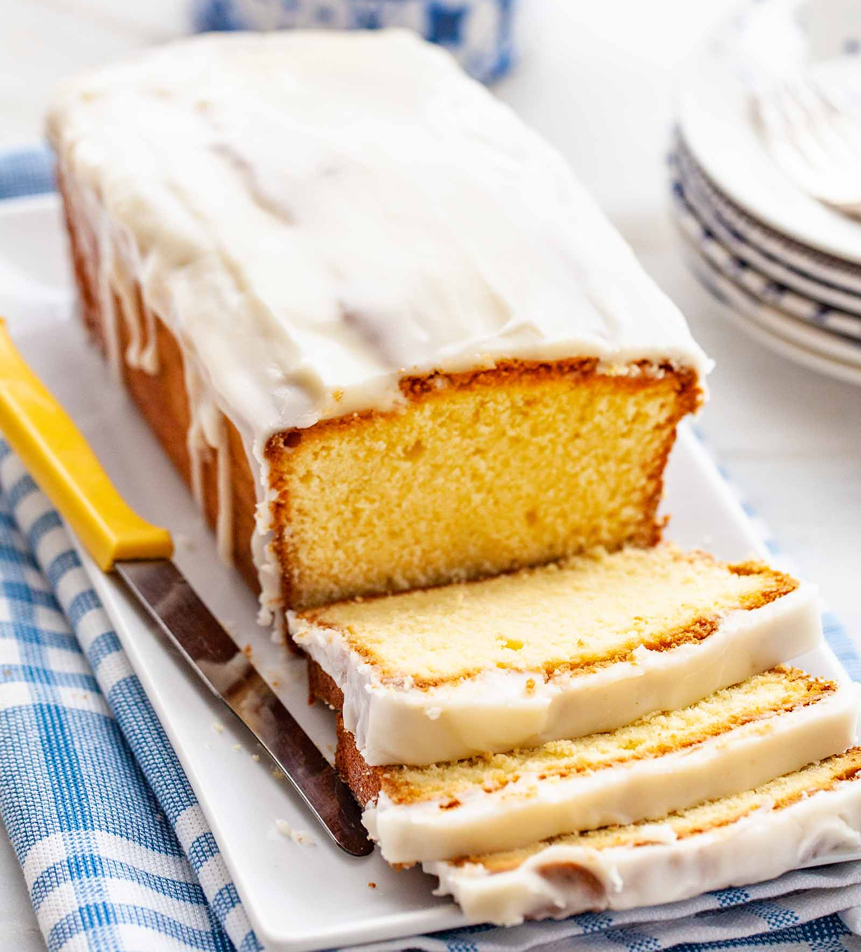
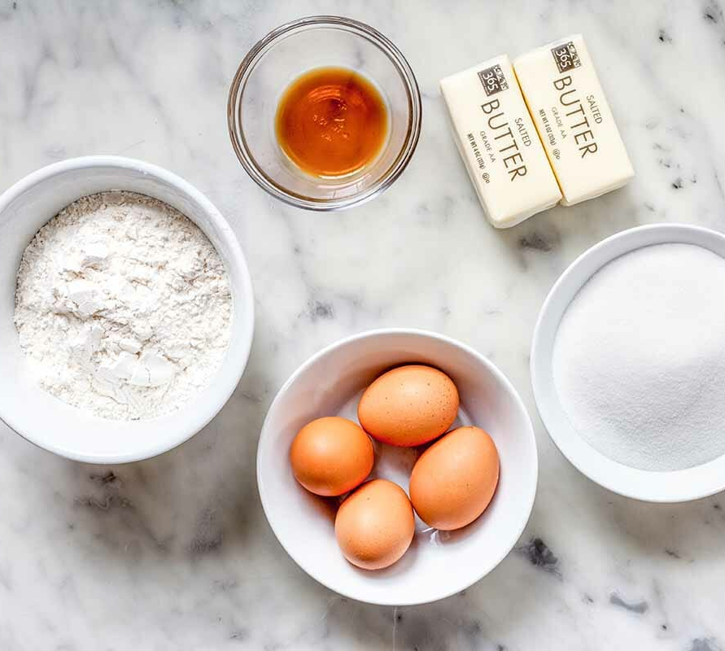
Cake Algorithm
Preheat oven
Mix dry ingredients
Mix wet ingredients
Mix wet ingredients into dry
Blah blah blah

Slide 5
Write an Algorithm for the best PB&J sandwich
Steps to change input
output
input

Slide 6
Write an algorithm for the BEST PB&J

Slide 7
Share

Slide 8
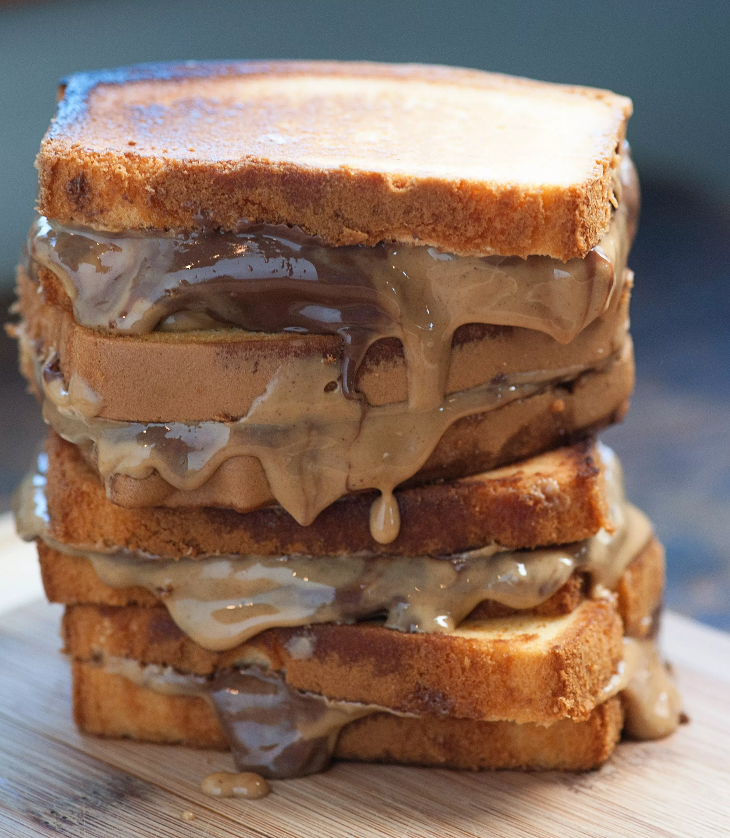
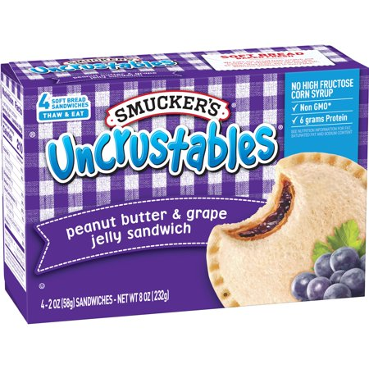
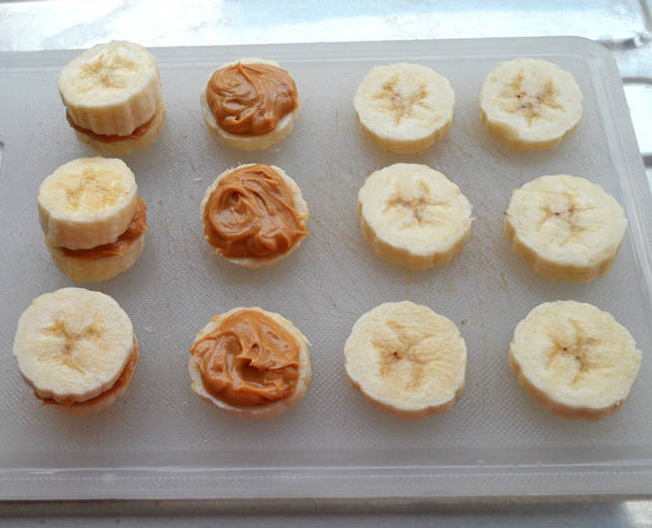
The “best” PB&J sandwich could mean a lot
Notes:
What would someone want the tasiest? The healthiest?

Slide 9
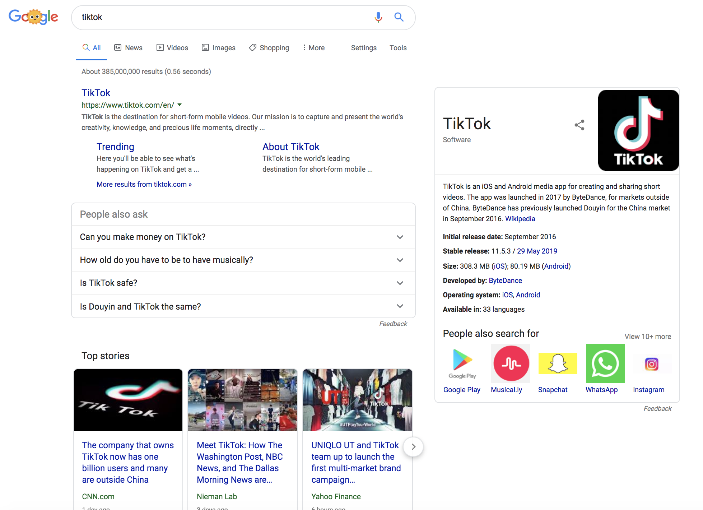
What do you think Google Search results are optimized for?

Slide 10
How do we decide what an algorithm should optimize for?
Notes:
TBD

